Slide 1
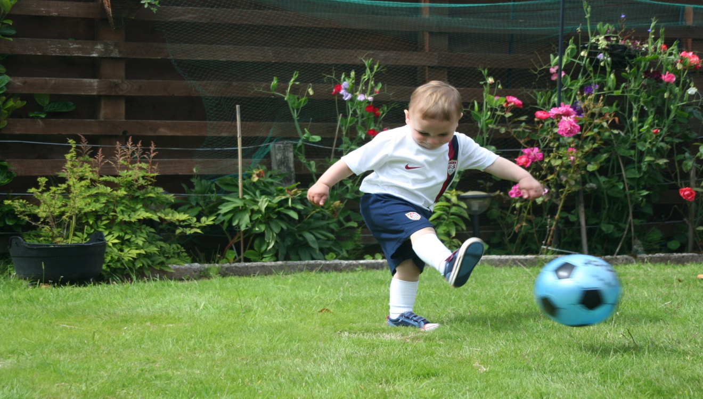
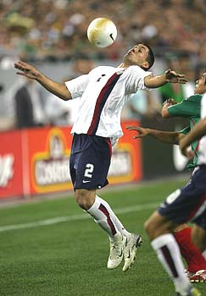
Long-Term Athletic Development
(LTAD)
Why is Quality Training More Important than Playing Games?
US Youth Soccer Coaching Committee
1

Slide 2
US Youth Soccer Coaching Committee
Long-Term Athletic Development
A high volume of ball contacts and repeated exposure to standard tactical situations are the most important elements of the player development process for pre-teens and those
navigating the turmoil of adolescence.
Fundamental muscle memory patterns are established through the myelinization process in the pre-teen years and this developmental window is regarded as the most critical period for the evolution of competent technicians and the rise of expressive soccer personalities.
2

Slide 3

US Youth Soccer Coaching Committee
Long-Term Athletic Development
It is an accepted principle that in any of life’s endeavors, reaching a level of excellence requires about 10,000 hours of active and intense preparation.
As a long-term athletic development (LTAD) sport, the best predictor of future soccer ability is the time invested in deliberate “deep” practice.
Time In = Skill Out.

Slide 4
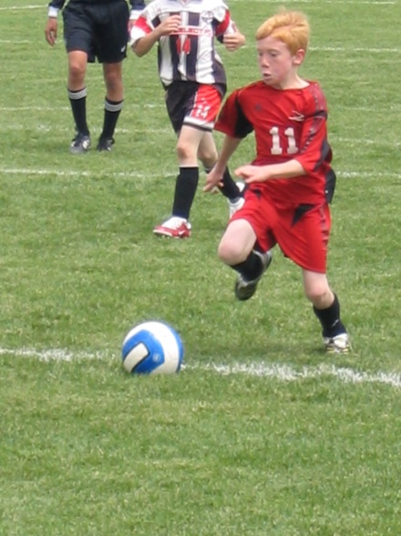
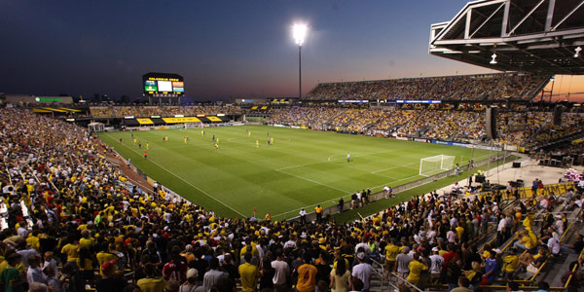
US Youth Soccer Coaching Committee
Long-Term Athletic Development
To maximize soccer potential, aspiring young players…
Must be self-motivated to engage in challenging and purposeful training in order to
  a) Improve technical range and efficiency.
    b) Overcome deficiencies.
Must be receptive to critical feedback.

Slide 5
US Youth Soccer Coaching Committee
Long-Term Athletic Development
In the free play era, motivated young soccer players kicked and headed their ball against a wall; controlled their ball as it rebounded from curbs, walls, fences and playmates; and played small, medium and large-sided games for hours on end.
It was not uncommon for enthusiastic kids to log 10-20 hours of soccer per week – or 2-3 hours per day, every day – in both isolated skill development and in unstructured games of varying configurations with players of varying ages.

Slide 6
US Youth Soccer Coaching Committee
Long-Term Athletic Development
Conservatively assuming only 10 months of playing soccer for 15 hours each week, 10,000 hours of training would take approximately 14 years to accumulate.
The top young players (professional and amateur) typically break into their club’s first team in their late teens or early 20’s and reach their prime by their mid- to late-20’s.
For the top goalkeepers, the maturational curve is slower, but many also compete well into their 30’s.
6

Slide 7
US Youth Soccer Coaching Committee
Long-Term Athletic Development
In the free play cultures, organized sport began around U-12. Young players often experienced a ratio of up to 20:0 when comparing hours of practice against hours of game play.
 | Free Play Cultures (U-6/8/10) | Modern Society (U-6/8/10) | Free Play Cultures (U-14+) | Modern Society (U-14+)
Average # Practice Hours Per Week (estimated) | 10-20 | 2-4 | 8-14 | 2-8
Average # of Games Per Week (estimated) | 0 | 2 | 1-3 | 2-5
Average # Tournaments Per Year (estimated) | 0 | 0-4 | 0-2 | 1-10
For today’s average player, the time allotted to soccer practice during the typical week may be no more than 3-4 hours and it is not uncommon for players to play more than they practice.

Slide 8
US Youth Soccer Coaching Committee
Long-Term Athletic Development
To compensate for these societal changes, the best youth coaches use the ideals of the free play culture and accelerate learning through individual skill activities and competition in a variety of conditioned small-sided games.
They have adopted the inclusive “Play Day Model” for their youngest players; they promote individual technical challenges as club-wide initiatives; they offer remedial programs to those who are motivated to self-train; and, they provide opportunities to train 3-4 nights per week.
8

Slide 9
US Youth Soccer Coaching Committee
Long-Term Athletic Development
To make significant gains in ability, players must be willing to engage in “deep” practice, which takes time and effort and serves to minimize limitations and maximize strengths.
The top players have always been self-made through deep practice, which is observed in those who arrive early for training and leave late; who purposefully work on their ball skills during free time; who independently develop their fitness and strength; who study the game and the great players; who grow to love soccer and its traditions; and who relish the hard work and struggle required to make them better.
9

Slide 10
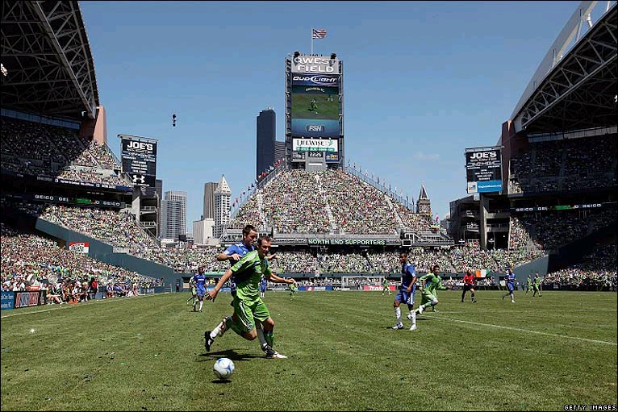
Game Play and LTAD
US Youth Soccer Coaching Committee
10

Slide 11
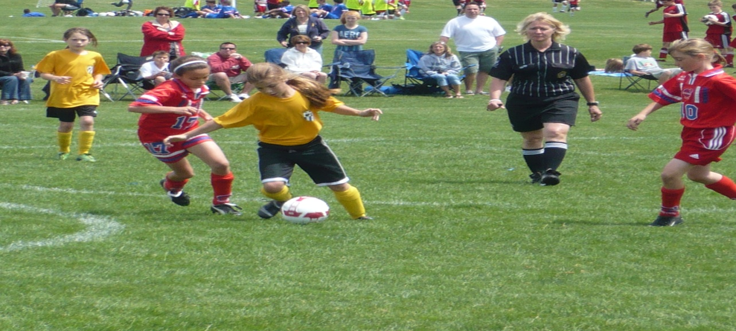
US Youth Soccer Coaching Committee
Game Play and LTAD
It is not uncommon for young players in the United States to compete in over 100 games during the calendar year. Many adults believe that game play is more important than training.
The numbers say otherwise….
11

Slide 12
US Youth Soccer Coaching Committee
Game Play and LTAD
A top level professional soccer match lasts 90 minutes. Each team is allowed a maximum of three substitutions. Once a player leaves the field, they cannot return. The “active” time, when the ball is in live play, is approximately 70% of the game time. Each player is in direct contact with the ball for an average of just over two minutes.
Level | Game Form | Game Roster | Game Time | Active Time | Ave. Participation | Ave. Playing Time
Professional | 11v11 | 14 | 90 mins | 63 mins | 78% | 2.25 mins
12

Slide 13
US Youth Soccer Coaching Committee
Level | Game Time | Active Time | Game Form | Max. Roster | Ave. Participation | Ave. Time Possession
U-10 | 50 minutes | 35 mins | 6v6 | 12 | 50% | 1.46 mins
U-12 | 60 minutes | 42 mins | 8v8 | 14 | 57% | 1.50 mins
U-14 | 70 minutes | 49 mins | 11v11 | 18 | 61% | 1.34 mins
U-16 | 80 minutes | 56 mins | 11v11 | 18 | 61% | 1.55 mins
U-18 | 90 minutes | 63 mins | 11v11 | 18 | 61% | 1.80 mins
Assuming maximum game rosters and equal playing time, the table above shows that playing 100 games per season produces a maximum of around 180 minutes of ball possession.
Even at the professional level, playing 100 games in a season would only raise that average to around 225 minutes.
13

Slide 14
US Youth Soccer Coaching Committee
In contrast, TEN well-planned training sessions will produce about the same amount of ball possessions as 100 games.
Training Activity | Player: Ball Ratio | Ave Time | Active Participation | Ave. Time Possession
Warm-up: Free Play (~3v3) | 6:1 | 15 mins | 100% | 2.5 mins
Individual Skill Development | 1:1 | 15 mins | 100% | 7.5 mins
2v2 Ladder | 4:1 | 20 mins | 100% | 5 mins
4v4 Conditioned Games | 8:1 | 30 mins | 100% | 3.75 mins
Game Form Practice 6v6 / 8v8 / 11v11 | 16:1 | 30 mins | 100% | 2.5 mins
Total Average Time of Possession |  |  |  | 21.25 mins
In short, three to four weeks of training can be more productive than one full year of games!
14

Slide 15
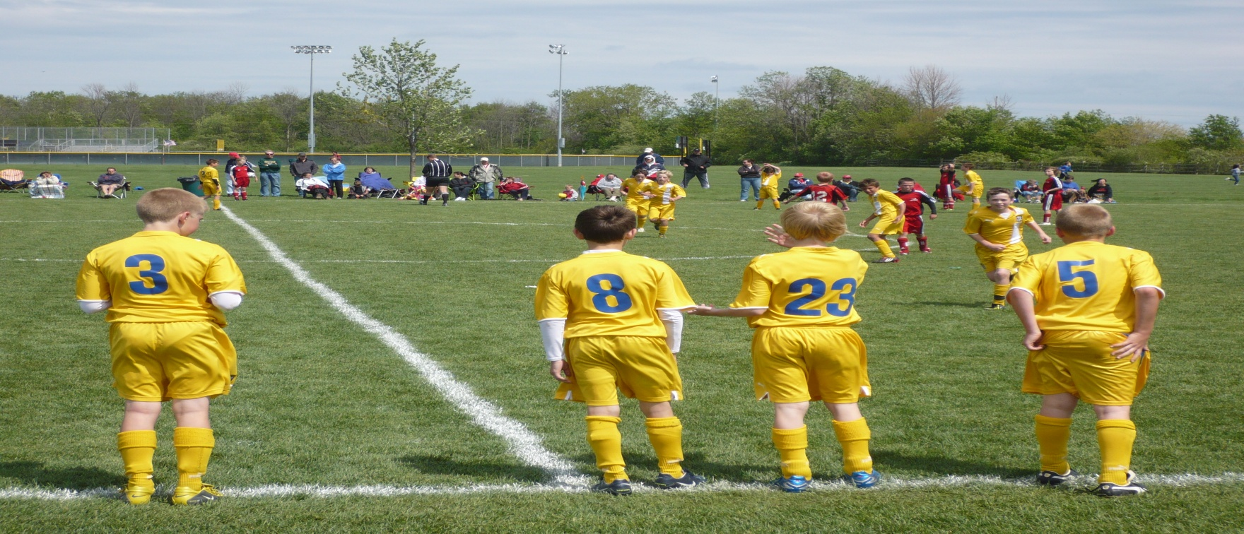
US Youth Soccer Coaching Committee
Game Play and LTAD
Stated another way, attending well-planned training sessions for SIX MONTHS can produce the same number of ball possessions as SIX YEARS of playing 100 games per season.
15

Slide 16
US Youth Soccer Coaching Committee
Even for the very best players who rarely leave the field,
the average time of possession is still less than
3 minutes per game; or <300 minutes per 100 game season.
Level | Game Time | Active Time | Game Form | Player to Ball Ratio | Ave. Participation | Ave. Time Possession
U-10 | 50 minutes | 35 mins | 6v6 | 12:1 | 100% | 2.92 mins
U-12 | 60 minutes | 42 mins | 8v8 | 16:1 | 100% | 2.62 mins
U-14 | 70 minutes | 49 mins | 11v11 | 22:1 | 100% | 2.23 mins
U-16 | 80 minutes | 56 mins | 11v11 | 22:1 | 100% | 2.55 mins
U-18 | 90 minutes | 63 mins | 11v11 | 22:1 | 100% | 2.86 mins
300 minutes of ball possession can be achieved in
approximately fourteen well-organized training sessions, which would take just over a month.

